Slide 1
Making Software Deployments Suck Less
>_
#!
Presented by:
Adam the Automator

Slide 2

PS> Whoami
Microsoft Cloud/Datacenter Management MVP
Pluralsight Author
PowerShell Developer/Trainer
Freelance Writer
adamtheautomator.com
Twitter: @adbertram

Slide 3

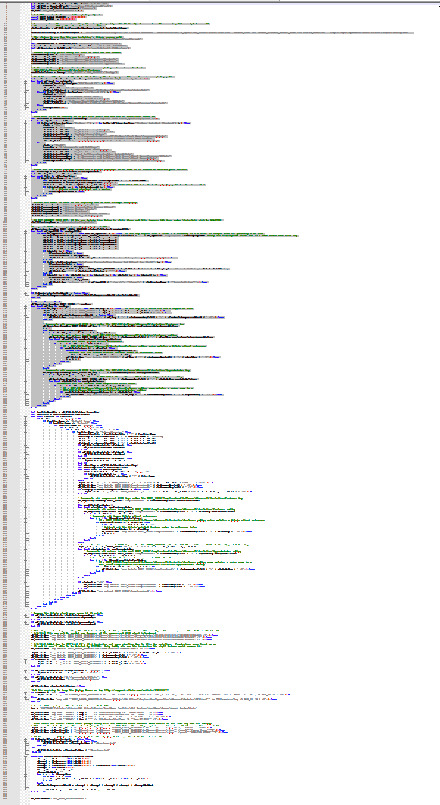
The 100 Hour Week
What on earth would require 100 hours in a week?
It rhymes with “itrix”
Lots of config differences
Helpdesk calls (My icon!)
Finance is down!
Kill me now!
Sleep
Boss: WTF? Me: Yep
Notes:
Anyone worked 100 hours in a week? …was it what you’d consider fun?
Application that rhymes with itrix that needed upgraded enterprise-wide from 12.4 to 13.
This app required different configurations whether it was a thin client, x86/x64, desktop, etc.
Citrix admin comes up to me on Friday..
Used the methodology for an old version and thought it’d work for the new version.
Pushed out to group on Monday evening..minor problems…fixed.
- Tested checking if in ARP and a single Citrix application..worked
Helpdesk calls about icon that’s changed the next day
Pushed out again on Tuesday evening..minor problems..fixed
Finance calls in a panic on Wednesday morning that their application won’t run.
- we didn’t test that application. It required another registry key to enable single sign on
The week continues like this until I eventually accumulated 100 hours
I was a consultant at the time for this client and my boss emailed me and said “did you make a typo on your timesheet”?
This could have been prevented if the versions didn’t change so much.

Slide 4
Manual Software Deployment Workflow
Test software install/uninstall/detection on a VM to gather msiexec, setup.exe, etc syntax
Create a package folder for SCCM
Copy all installer files to package folder
Create SCCM application
Distribute package to distribution points

Slide 5
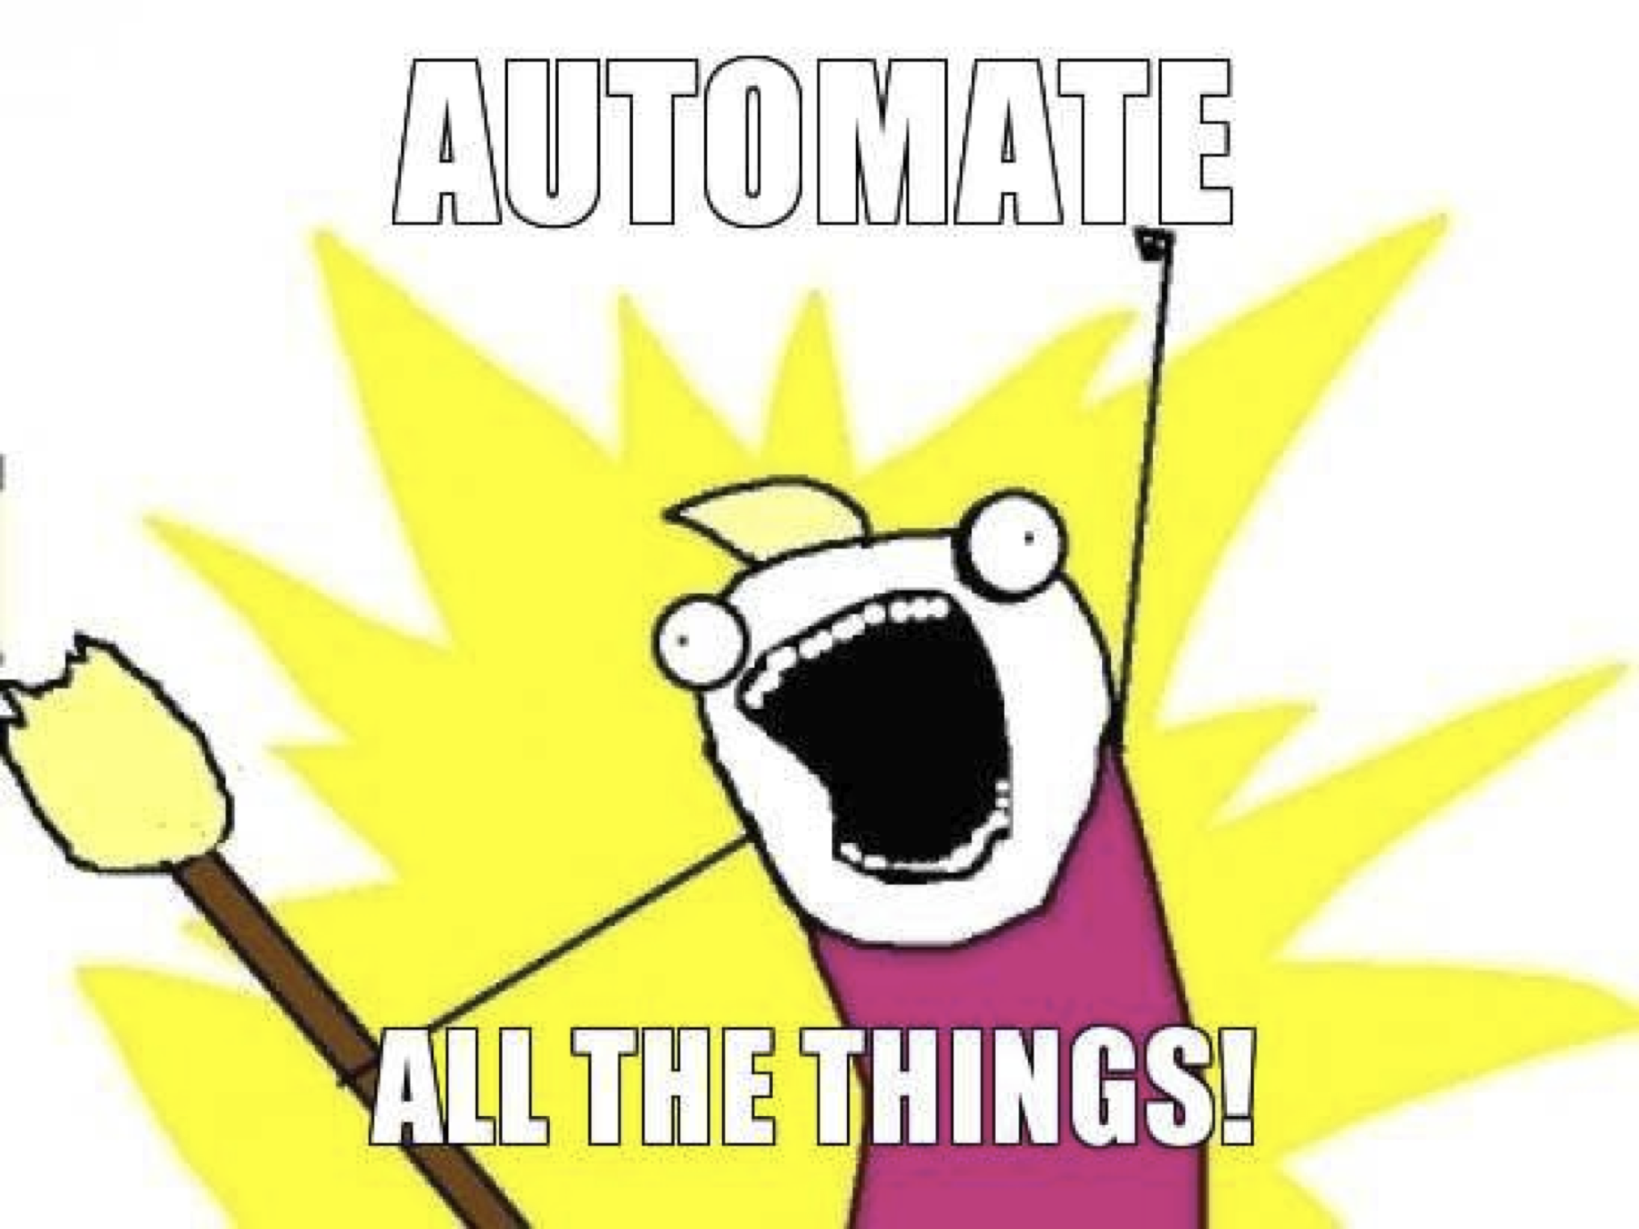
This Can all be Automated

Slide 6
Automate in Two Places
Client-side
Server-side

Slide 7
Treat all Software Equally Client-Side
Build a management framework in PowerShell
Pull all decision-making into PowerShell on the client
Install-Software instead of msiexec /i
Remove-Software instead of msiexec /x
Use ConfigMgr for delivery, execution, detection and reporting only

Slide 8
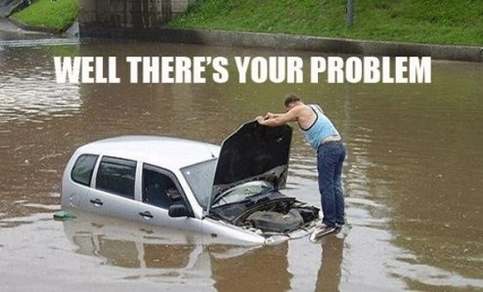
Client Side: No Software is the Same
Lack of Package Standardization
Hard to define “installed” and “uninstalled”
Post-install configuration needed
Cleanup work post-uninstall

Slide 9
Remove You from the Server-Side
New-CMMyApplication
Package folder creation
Standardized PowerShell script names
SCCM application creation
Force a standard with script validation

Slide 10
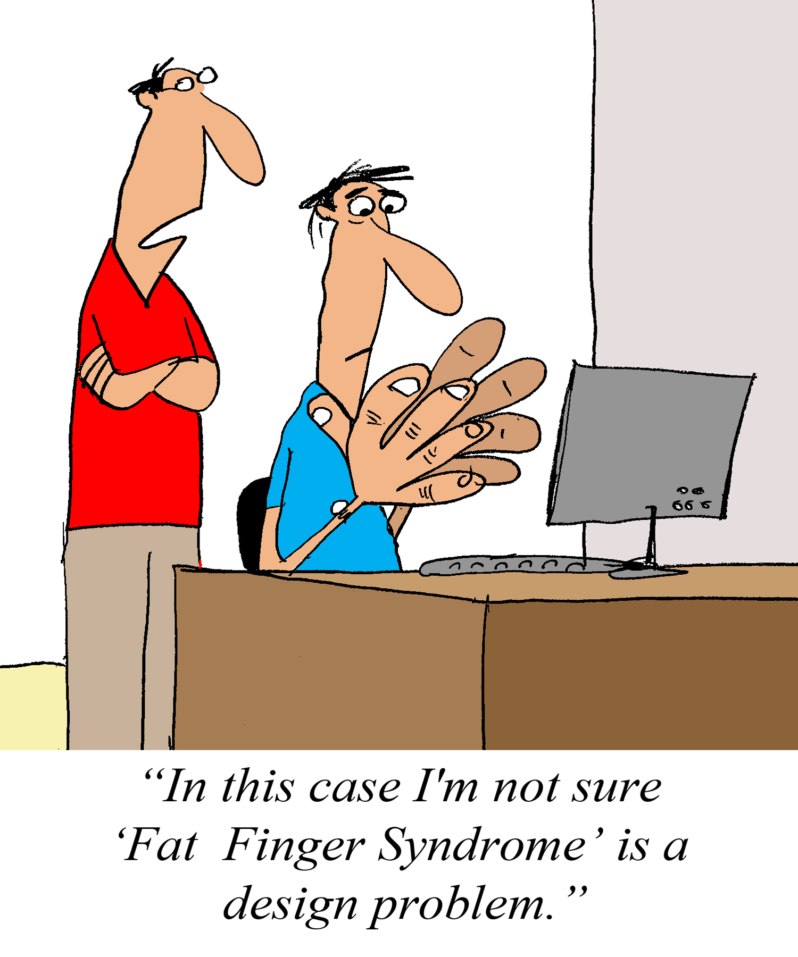
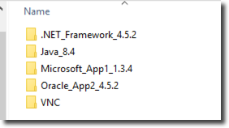
Server-Side: Humans are Dumb
Notes:
We might try to standardize but we forget our scheme, we get busy and before long that scheme no longer exists.
We also have multiple people trying to do this and it doesn’t work out

Slide 11
Demo
Automating a Software Deployment End to End

Slide 12
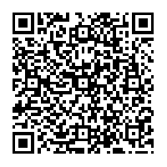
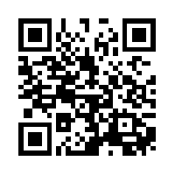
Thanks!
Blog: adamtheautomator.com
Pluralsight Training: http://bit.ly/adambpluralsight
Twitter: @adbertram
Scripts and Slides
SoftwareInstallManager Module
http://bit.ly/swmscug
http://bit.ly/softwareinstall

